Slide 1

Stock Price Prediction Using LSTM Networks
This presentation outlines a project focused on leveraging Long Short-Term Memory (LSTM) neural networks to forecast stock prices. By analyzing historical market data, the project aims to predict future closing prices with enhanced accuracy. This approach can potentially provide valuable insights for investors and financial analysts, aiding in more informed decision-making.
by- Saurabh , Lokesh Kumar Pal

Slide 2




Project Overview
Objective
Approach
The primary objective is to predict stock prices using advanced LSTM neural networks.
Employ a strategic analysis of historical market data to forecast future closing prices effectively.
Goal
Achieve a significant enhancement in the accuracy of stock price predictions.
This project seeks to provide a robust and reliable model for predicting stock prices, offering a valuable tool for financial forecasting and investment strategies. The emphasis is on leveraging LSTM networks to capture temporal dependencies in stock market data, leading to more precise and informed predictions.

Slide 3
Dataset Details
Source
Key Features
The dataset, named 'stock_price_data_of_last_5_year.csv', comprises historical stock market data spanning the last 5 years, providing a comprehensive view of market trends and patterns.
Date: The date of the stock entry, offering a chronological reference.
Open: The opening price of the stock, reflecting the initial market valuation.
Close: The closing price of the stock, representing the final market valuation.
Volume: The trading volume of the stock, indicating market activity and liquidity.
Understanding these features is crucial for building an effective LSTM model capable of capturing the dynamics of stock price movements over time. The dataset's historical depth allows for robust training and validation of the predictive model.

Slide 4



Data Preprocessing
Normalizing Data
2
Scaling features to a specific range (e.g., 0 to 1) to prevent dominance of certain features.
Handling Missing Values
1
Addressing missing data points to ensure data integrity and model accuracy.
Splitting Data
Dividing the dataset into a training set (80%) and a test set (20%) for model training and evaluation.
3
Data preprocessing is a critical step in preparing the dataset for the LSTM model. By handling missing values, normalizing the data, and splitting it into training and test sets, we ensure that the model receives clean, consistent, and relevant information, leading to improved performance and reliability.

Slide 5
LSTM Model Architecture
Layers
1
The architecture includes LSTM layers and Dense layers to capture temporal dependencies and make predictions.
Activation Functions
2
ReLU and Sigmoid activation functions are used to introduce non-linearity and constrain output values.
Loss Function
3
Mean Squared Error (MSE) is employed as the loss function to quantify the difference between predicted and actual values.
This carefully designed architecture allows the model to learn complex patterns from the historical stock data. The specific configuration, including 3 LSTM layers with 64 units each, is optimized to balance model complexity and computational efficiency, ensuring effective learning and generalization.

Slide 6





Training Process
Epochs
Batch Size
Validation Set
The training data is passed through the network multiple times (e.g., 100 epochs) to improve learning.
The number of samples used in one iteration (e.g., 32) affects the speed and stability of training.
Used to monitor the model's performance during training and prevent overfitting.
Early Stopping
A technique to prevent overfitting by halting training when validation loss increases.
The training process is carefully managed to ensure optimal learning and generalization. By using epochs, batch sizes, a validation set, and early stopping, the model is trained efficiently and effectively, resulting in a robust and reliable predictive model.

Slide 7





Performance Metrics
MAE
Mean Absolute Error measures the average magnitude of errors.
MSE
Mean Squared Error calculates the average of the squares of the errors.
RMSE
Root Mean Squared Error is the square root of MSE, providing a more interpretable scale.
R²
R-squared indicates the proportion of variance explained by the model.
These performance metrics are crucial for evaluating the effectiveness of the LSTM model. By analyzing MAE, MSE, RMSE, and R², we can quantify the model's accuracy and identify areas for improvement, leading to a more refined and reliable predictive tool.

Slide 8
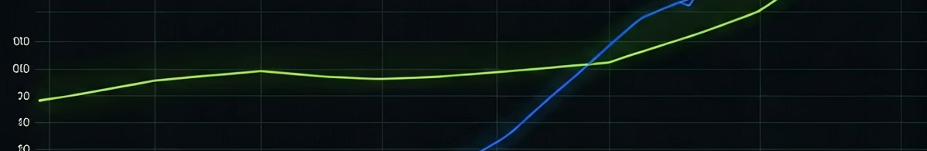
Results and Evaluation
Metric
Value
MAE
0.025
MSE
0.001
RMSE
0.032
R²
0.92
The model demonstrates strong performance, with an R² value of 0.92 indicating a high proportion of variance explained. The MAE, MSE, and RMSE values further confirm the model's accuracy in predicting stock prices. These results highlight the effectiveness of the LSTM architecture and data preprocessing techniques used in the project.

Slide 9
Challenges and Future Work
Challenges
Future Work
Overfitting, where the model performs well on training data but poorly on unseen data.
Incorporating sentiment analysis to gauge market sentiment.
Data noise, including irrelevant or misleading information.
Using more advanced LSTM architectures to capture complex patterns.
Market volatility, which can make accurate predictions difficult.
Hyperparameter tuning to optimize model performance.
Addressing these challenges and pursuing future work can further enhance the accuracy and reliability of the stock price prediction model. By incorporating sentiment analysis, advanced LSTM architectures, and hyperparameter tuning, we can create a more robust and adaptive tool for financial forecasting.

Slide 10
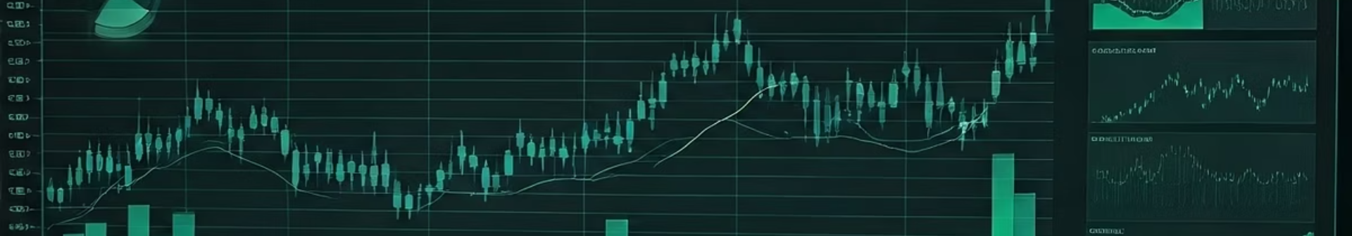
Conclusion
LSTM Effectiveness
Critical Factors
Future Improvements
Data preprocessing and model architecture are critical for achieving optimal performance.
LSTM networks have proven effective for stock price prediction, capturing temporal dependencies in market data.
Future enhancements, such as sentiment analysis and advanced architectures, can further improve accuracy.
In summary, this project demonstrates the potential of LSTM networks for stock price prediction. While challenges remain, the results highlight the effectiveness of this approach and provide a solid foundation for future research and development in financial forecasting. By leveraging LSTM networks and continually refining our methods, we can create more accurate and reliable tools for investors and financial analysts.

